Slide 1
When students sprint: Experiences with Athletic Software Engineering
Philip Johnson
Information and Computer Sciences
University of Hawaii
Honolulu, HI USA

Slide 2


Slide 3
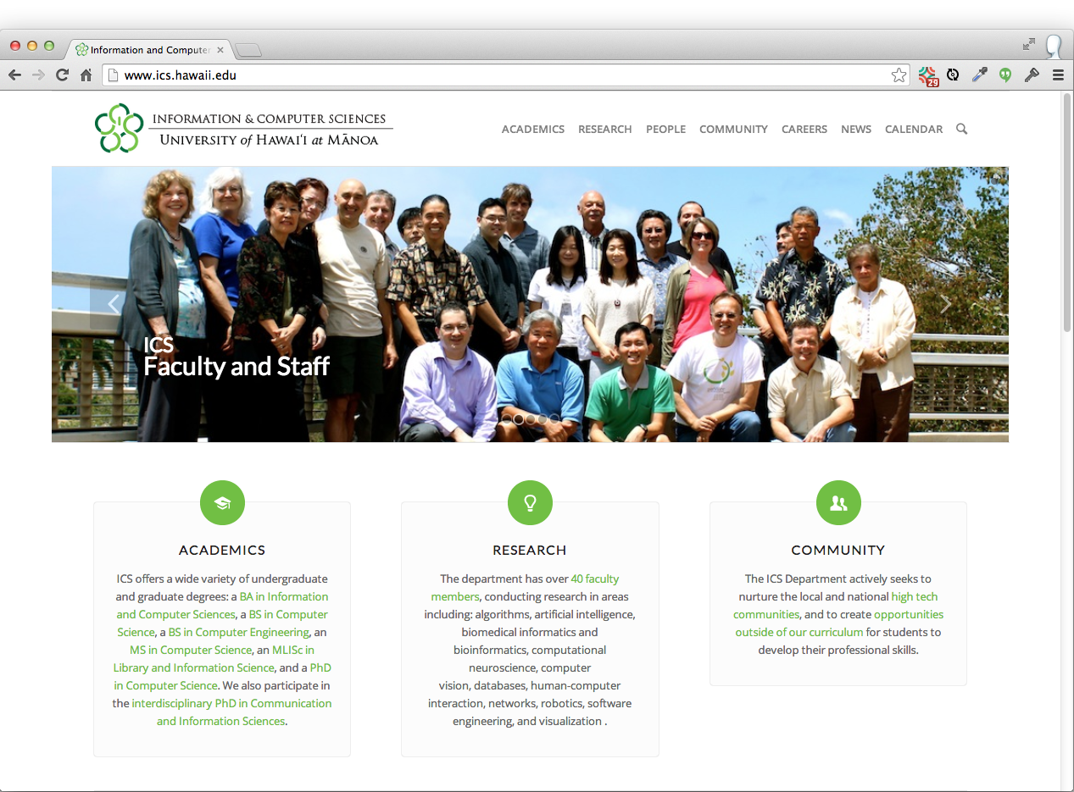

Slide 4
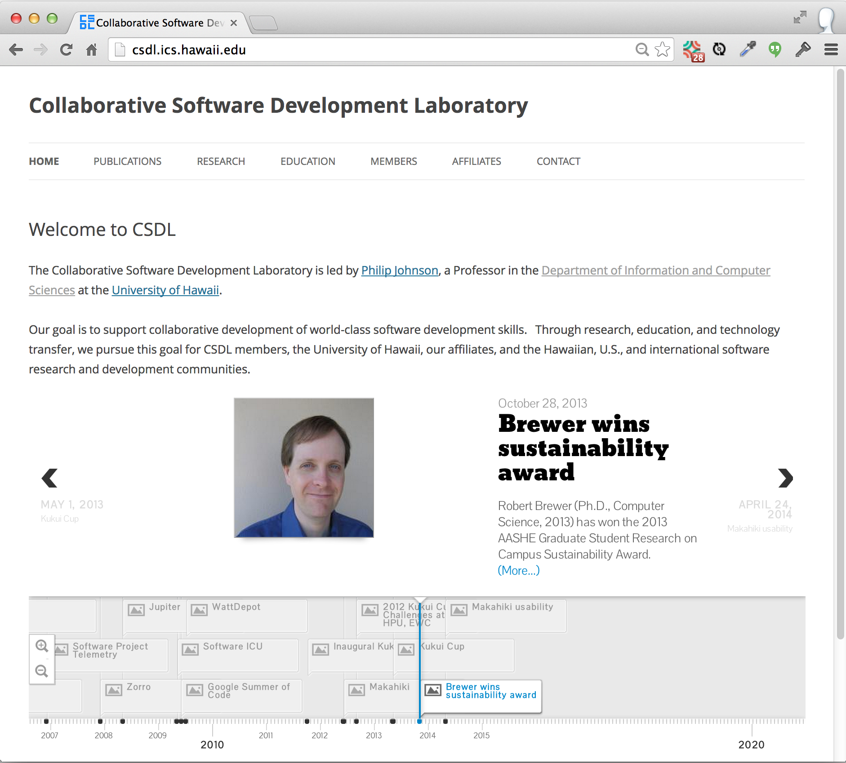

Slide 5
Learning outcomes
New ways to experiment on your students in the classroom
Free, open source technology you can evaluate for use in your courses

Slide 6
Prelude: Bloom's Taxonomy
Create
Evaluate
Analyze
Apply
Understand
Remember

Slide 7
Prelude: Bloom's Taxonomy
Teach others
Create
Practice by doing
Evaluate
Discussion group
Analyze
Demonstration
Apply
Understand
Audio-Visual
Remember
Lecture/Reading

Slide 8
Prelude: Bloom's Taxonomy
Teach others
90%
Create
Practice by doing
75%
Evaluate
Discussion group
50%
Analyze
Demonstration
30%
Apply
Audio-Visual
20%
Understand
10%
Remember
Lecture/Reading

Slide 9

Evolution of my pedagogy

Slide 10


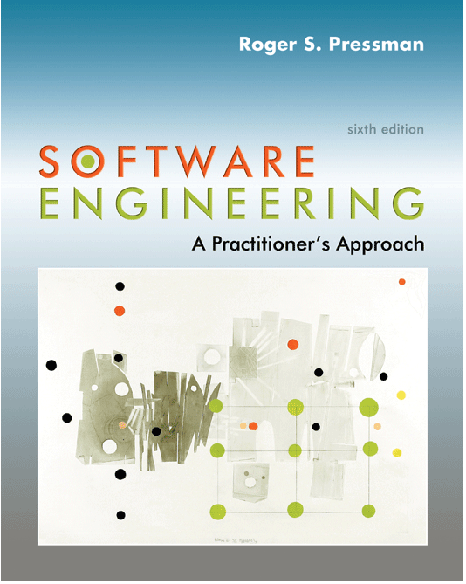

Try 1: Survey textbook + lecture

Slide 11
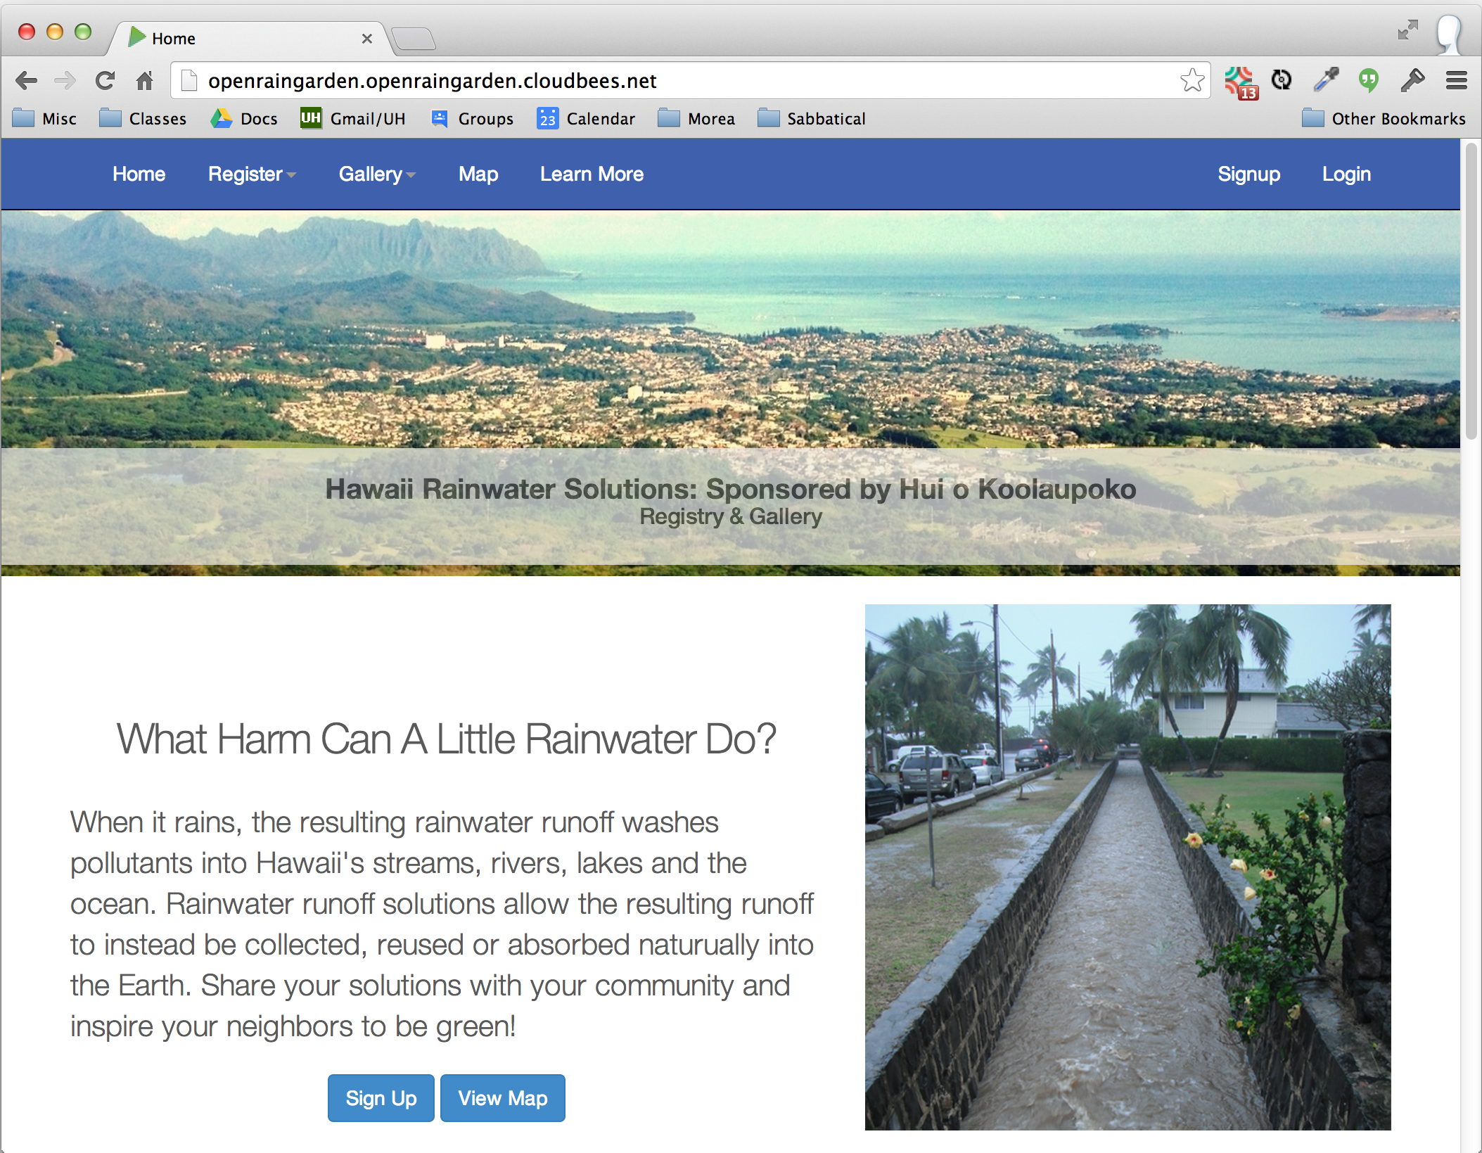
Try 2: Community projects

Slide 12
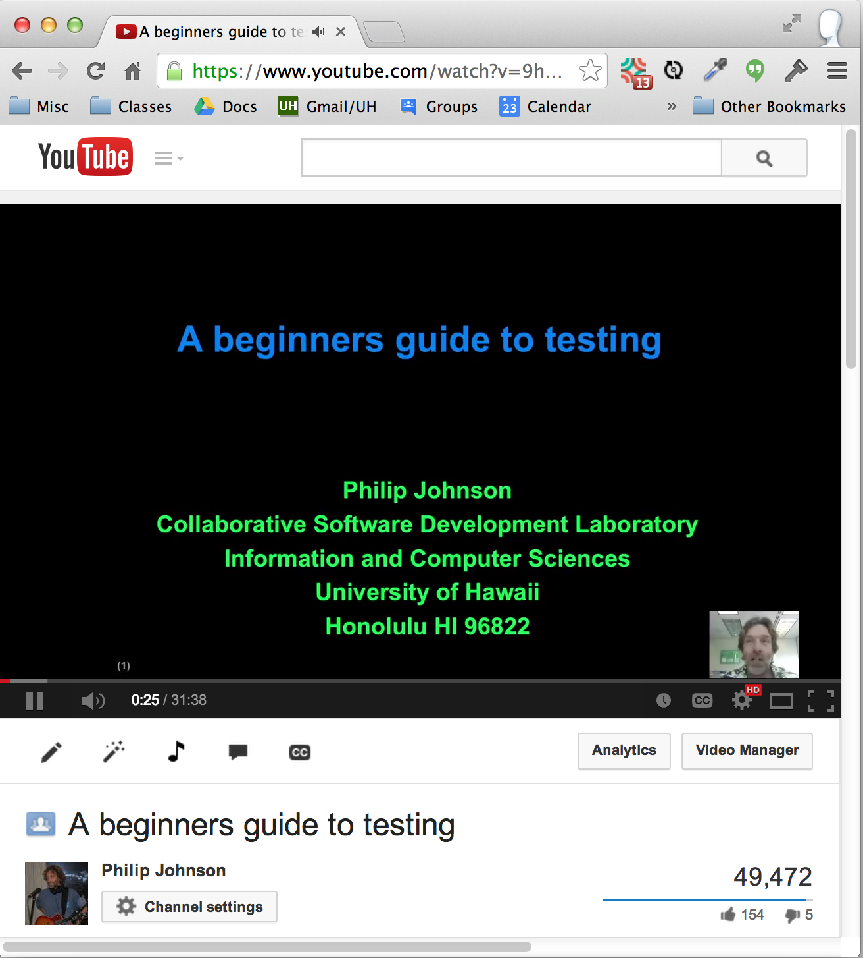
Try 3: Flipped classroom

Slide 13
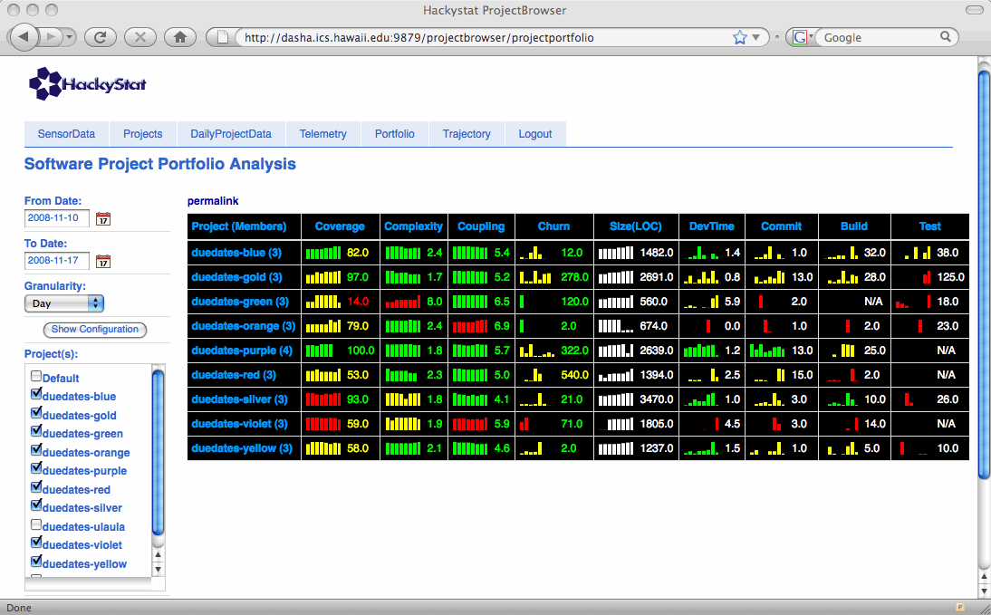
Try 4: Super Metrics!

Slide 14
Summary
Approach | Significant strength | Significant weakness
Survey + Lecture | High quality texts | Low engagement
Community projects | High potential engagement | Variability in engagement
Flipped classroom | "Active" classrooms | 60 min YouTube videos
Super Metrics | Fine grained insight into developer behavior | Complexity

Slide 15
Try 5: Athletic Software Engineering

Slide 17


Slide 18
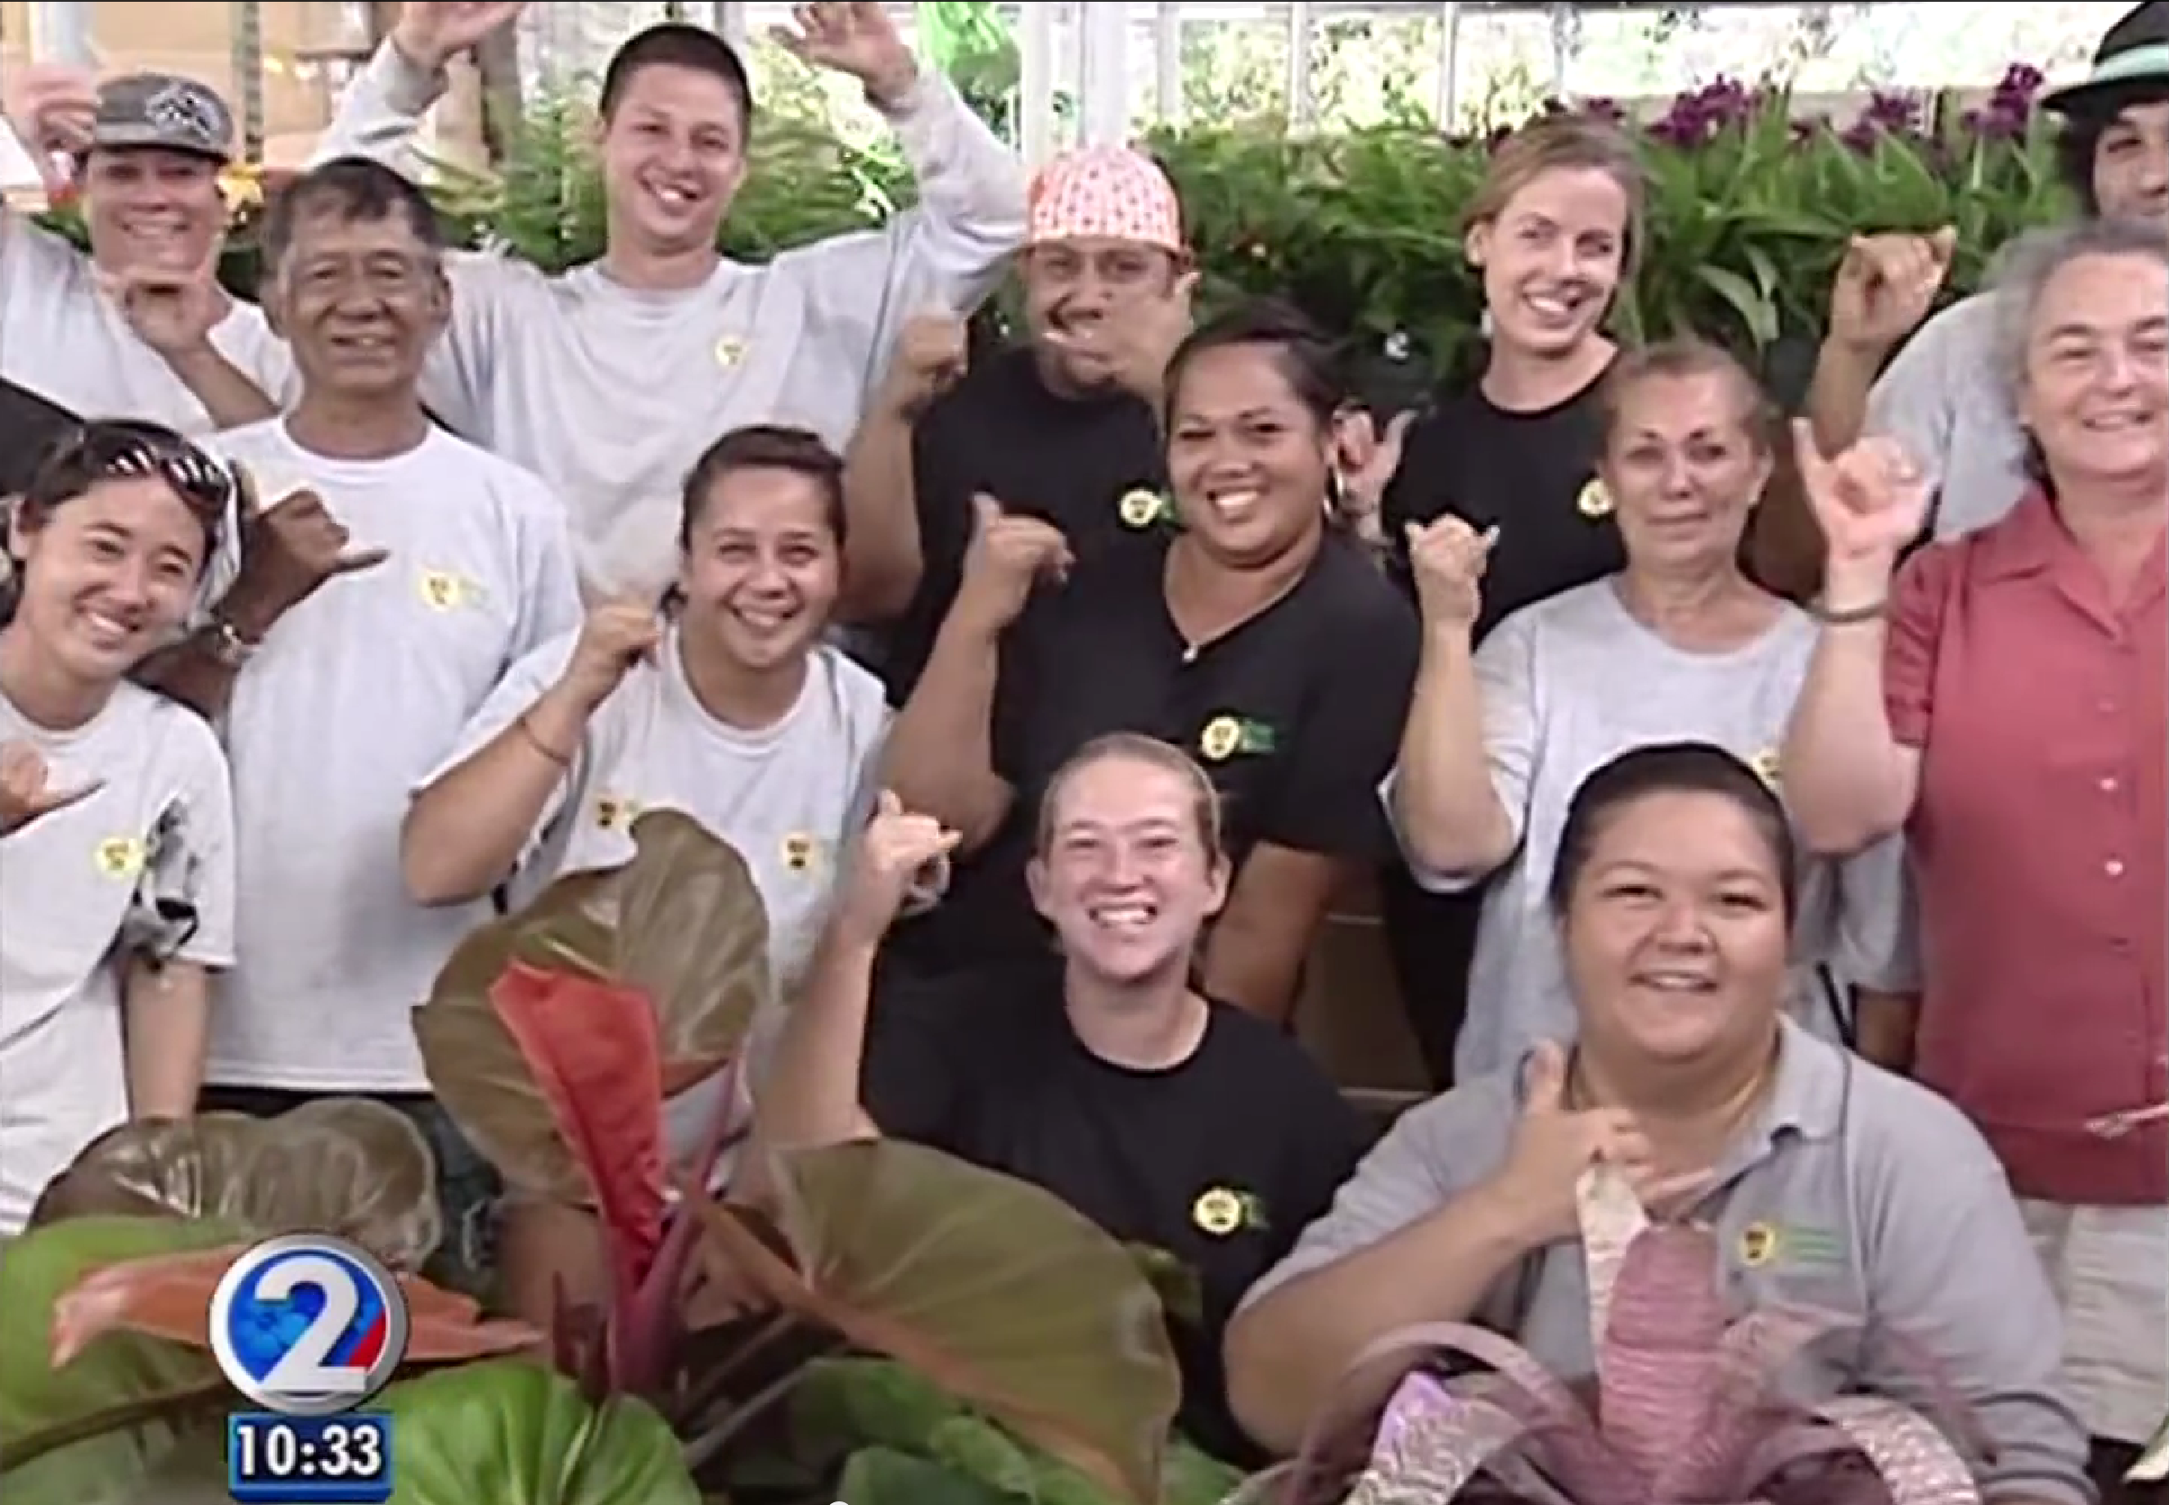

Slide 19
Why is it so hard to teach students to program well?

Slide 20
Why is it so hard to teach students to program well?

Slide 21
How does one create a classroom environment in which students put in the tremendous amount of time required to learn to program well?

Slide 22
How does one create a classroom environment in which students put in the tremendous amount of time required to learn to program well?

Slide 23
How can students learn to program well as efficiently as possible?

Slide 24
How can students learn to program well as efficiently as possible!

